Slide 1
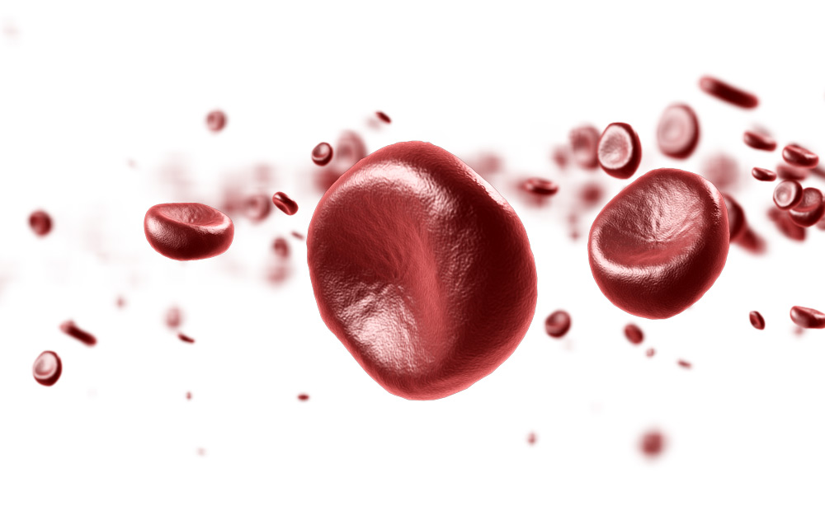
Blood Donation
The facts, history, and issues regarding blood
transfusion and donation

Slide 2
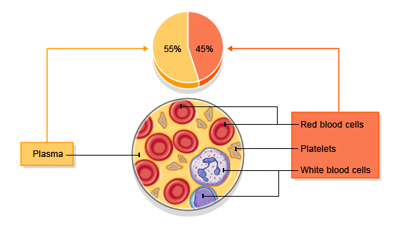
Parts of the Blood…
Red Blood Cells
While Blood Cells
Platelets &
Plasma.
No scientists or laboratory in the world has ever been able to produce blood with all its qualities.
Everyday thousands die due to the non-availability of blood.
Notes:
Oxygen is picked up in the lungs by red blood cells and carried to body tissues.
Red blood cells carry carbon dioxide from the tissues to the lungs.
Blood cells are produced in bone marrow.
White blood cells are part of the immune response and fight foreign cells and produce antibodies.
Platelets form clots around injuries to prevent blood loss and promote healing
Plasma is the liquid part of your blood in which red cells and platelets float.
Plasma is mostly water, but the proteins it contains are necessary for life.

Slide 3
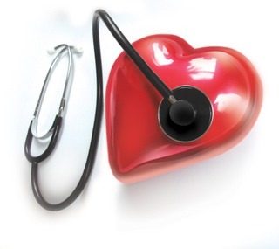
Some Facts…
Blood transfusion is the process of transferring blood or blood components from one person to another
Transfusions are used to treat Hemophilia, Leukemia, Surgery,
Trauma/Accidents & Burns

Slide 4
A person has 5 - 6 liters of blood in his body.
350ml of blood can save as many as three lives.
Every two seconds, someone in India needs blood.
One out of every three of us will need blood
in our life time.
Even with all of today’s technology,
there is no substitute for blood.

Slide 5
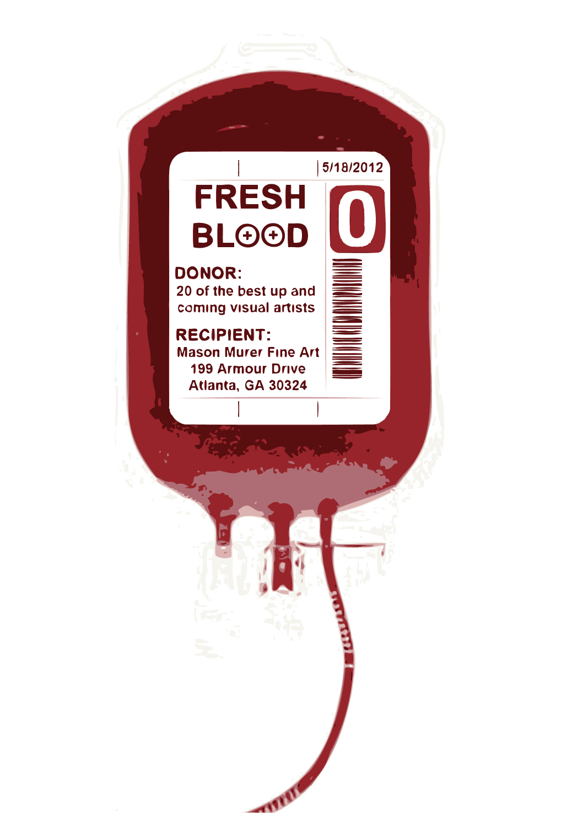
Blood supplies are often low, and drop
usually n the summer
All donated blood in India is tested for HIV,
Hepatitis, and other diseases
75% of donors donate only ONCE a year.
If a donor could donate blood just twice a year; there would be NO shortages.

Slide 6
Before Donation
Checking of your pulse, blood pressure, temperature and hemoglobin.
Questions about risk behaviors related to diseases
Signature of your application to confirm that you have read and understood the information.
Notes:
Oxygen is picked up in the lungs by red blood cells and carried to body tissues.
Red blood cells carry carbon dioxide from the tissues to the lungs.
Blood cells are produced in bone marrow.
White blood cells are part of the immune response and fight foreign cells and produce antibodies.
Platelets form clots around injuries to prevent blood loss and promote healing
Plasma is the liquid part of your blood in which red cells and platelets float.
Plasma is mostly water, but the proteins it contains are necessary for life.

Slide 7
After Donation
Apply pressure for about five minutes to stop any bleeding.
Keep the bandage that covers the puncture on for six hours.
Avoid any intense physical activity for six to eight hours.
Depending on your job or the sport you practice, you may need to wait a while before being active.
Notes:
Oxygen is picked up in the lungs by red blood cells and carried to body tissues.
Red blood cells carry carbon dioxide from the tissues to the lungs.
Blood cells are produced in bone marrow.
White blood cells are part of the immune response and fight foreign cells and produce antibodies.
Platelets form clots around injuries to prevent blood loss and promote healing
Plasma is the liquid part of your blood in which red cells and platelets float.
Plasma is mostly water, but the proteins it contains are necessary for life.

Slide 8
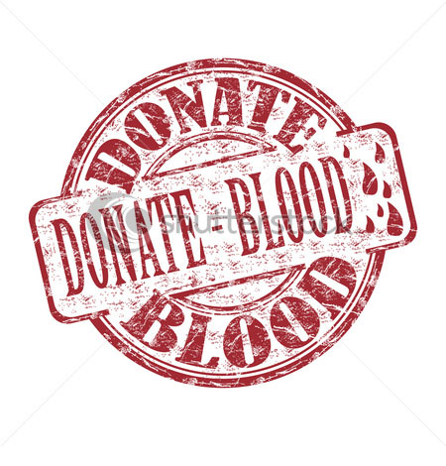
A person can donate blood every 90 days (3 months).
Body recovers the Blood very quickly:
Blood plasma volume
– within 24 - 48 hours
Red Blood Cells
– in about 3 weeks
Platelets & White Blood Cells
– within minutes

Slide 9
Blood Groups
In 1901, Karl Landsteiner identified the A, B, AB and O blood types.
Each blood type contains a unique molecule called antigen, on the surface of the red blood cell.
If a person receives blood of the wrong type, then
these cells are attacked by antibodies.
Therefore, correct blood typing during
transfusions is essential.

Slide 10
Blood is taken ONLY from voluntary donors using sterile, disposable blood bags & instruments
Donated Blood is tested and separated into components benefiting
3-4 patients
It is safe to donate every 3 months
Donation criteria's
Age: 18 - 60 years
Weight : > 45 kgs
Hemoglobin level: >12 gms/dl
for men and >12.5 gms/dl for women
In good health
Donation Information
Notes:
Grams/deci litre = A metric unit of volume equal to one tenth of a litre so technicly 100 ml

Slide 11
Who can’t donate for
Life long | 1 year | 6 Months
Abnormal bleeding disorder Heart, Kidney, Liver Disorder Thyroid disorder, Epilepsy, Mental disorders Tuberculosis, Leprosy Asthma Cancer Insulin dependent diabetics | Surgery Typhoid Dog bite Unexplained weight loss Continuous low grade fever | Tattooing or body piercing Dental extraction Root canal treatment Malaria Vaccination

Slide 12
Female donors can’t donate blood……
During pregnancy
After delivery for one year
When lactating
During menstrual period
and for 7 days thereafter
Male donors can’t donate blood……
If consumed Alcohol in the
previous 24 hours

Slide 13
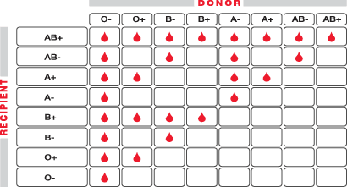
BLOOD COMPATIBILITY CHART
O- → Universal Donor
AB+ → Universal Receptor

Slide 14
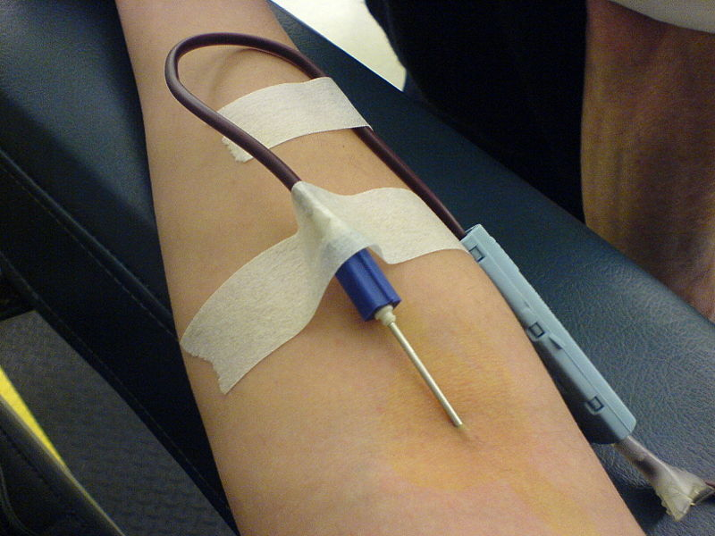
The Donor Must ….
Have had good
rest / sleep
Have had
light meal
Be mentally
prepared ☺

Slide 15
Advice
Drink lots of fluids for next 24 hours
Avoid smoking for one hour & alcohol till after a meal
Don’t use elevator to go up immediately after donation as it will
make blood rush to your feet & make you dizzy!
Avoid highly strenuous exercises & games for a day
If you feel dizzy, lie down & put your feet up. You
will be alright in 10-20 mins.
Remove band-aid after 4 hours. If it bleeds,
apply pressure & reapply band-aid. If bruised
and painful, apply cold-pack 4 to 5 times for
5 mins each. The bruise is due to blood seeping
into the surrounding tissue. It may take a few
days to get reabsorbed.

Slide 16
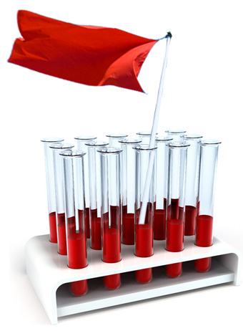
National Blood Donation Day 1st October
World Blood Donors Day
14th June
World Health Day
7th April

Slide 17
Make Blood Donation a HABIT
Donate regularly – every 3 months to commemorate special days like birthdays, anniversaries ….
Motivate others to donate
Refer your friends and relatives

Slide 18
A Note on TEJUS
TEJUS, a NGO formed by few vibrant likeminded professionals at Technopark and VSSC, focussing primarily on Voluntary Safe Blood donations among many other charitable activities in the line up. Voluntary blood donation is strongly promoted by TEJUS and has decided to create a strong voluntary blood donors database mainly by including the employees from Technopark and always open to people who
are interested to be the part of this fellowship.
Websites:
www.tejusindia.com
www.facebook.com/tejusindia

Slide 19
THANK YOU

